Slide 1



Netflix Shows Data Analysis
SQL Analysis and Data Visualization
This presentation provides an analysis of the Netflix Shows dataset using SQL queries to uncover interesting insights and trends. The findings are visualized using various charts to illustrate key patterns in Netflix's content library.
by Roy Ivia

Slide 2

Introduction
Dataset Overview
This dataset contains information about Netflix shows, including show type, title, director, cast, country, date added, release year, rating, duration, and more.
Objective :
To analyze the dataset using SQL queries and visualize the findings to gain insights into Netflix's content library.

Slide 3




Import Process.
Importing the Data
Downloaded the dataset in CSV format.
Opened MySQL Workbench and created a new database schema.
Loaded the CSV file into a new table
Investigating Further
I ran SQL queries to dive deeper into this relationship, examining how factors like product category and customer loyalty impacted the trend. The insights I uncovered were quite fascinating.
Challenges Faced:
Handling inconsistent delimiters and quotation marks.
Choosing appropriate data types for each column.
Managing null values in columns like director and cast.

Slide 4

Findings
Insight: Significant Increase in TV Shows Over the Years
Analysis revealed a marked increase in the number of TV shows added to Netflix in recent years compared to movies.
Implication: Indicates Netflix's strategic shift towards producing and acquiring more TV series content to engage viewers with ongoing subscriptions.

Slide 5
SQL Queries and Cool Facts
Total Count of Movies and TV Shows:
SELECT type, COUNT(*) as count FROM netflix_shows GROUP BY type;
The result showed a total of 100 Netflix Movies and TV shows in the dataset.
Distribution of Content Added Over the Years:
SELECT release_year, type, COUNT(*) as count FROM netflix_shows GROUP BY release_year, type ORDER BY release_year;
Cool Fact:
The number of TV shows added annually has increased, particularly in the past five years.
2021 had the highest number of releases with 53 releases

Slide 6

Questions and Insights
1
What are the most common content ratings?
SQL Query:
SELECT rating, COUNT(*) as count FROM netflix_shows GROUP BY rating ORDER BY count DESC;
Insight:
TV-MA and TV-14 are the most common ratings, reflecting a focus on mature and teen audiences.
2
Which countries produce the most content?
SQL Query:
SELECT country, COUNT(*) as count FROM netflix_shows GROUP BY country ORDER BY count DESC;
Insight:
The United States leads in content production, followed by India and the United Kingdom.

Slide 7
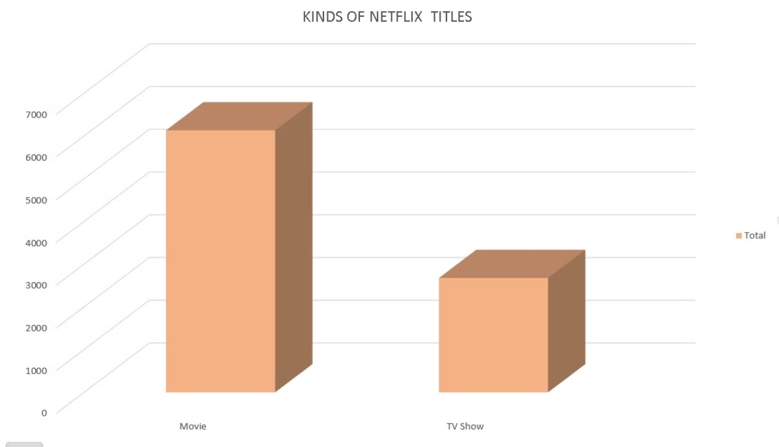
Data Visualization.
Bar Chart Comparing the number of movies versus TV shows :
Insight: Movies have a higher count than TV shows.

Slide 8
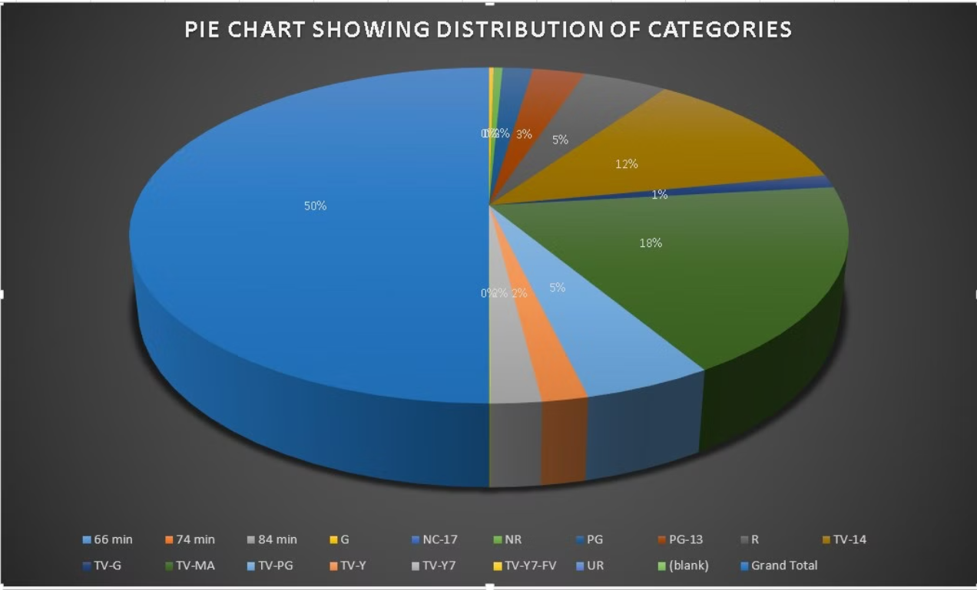
Pie Chart Showing Distribution of content ratings:
Insight: Majority of content is rated 66 min.

Slide 9
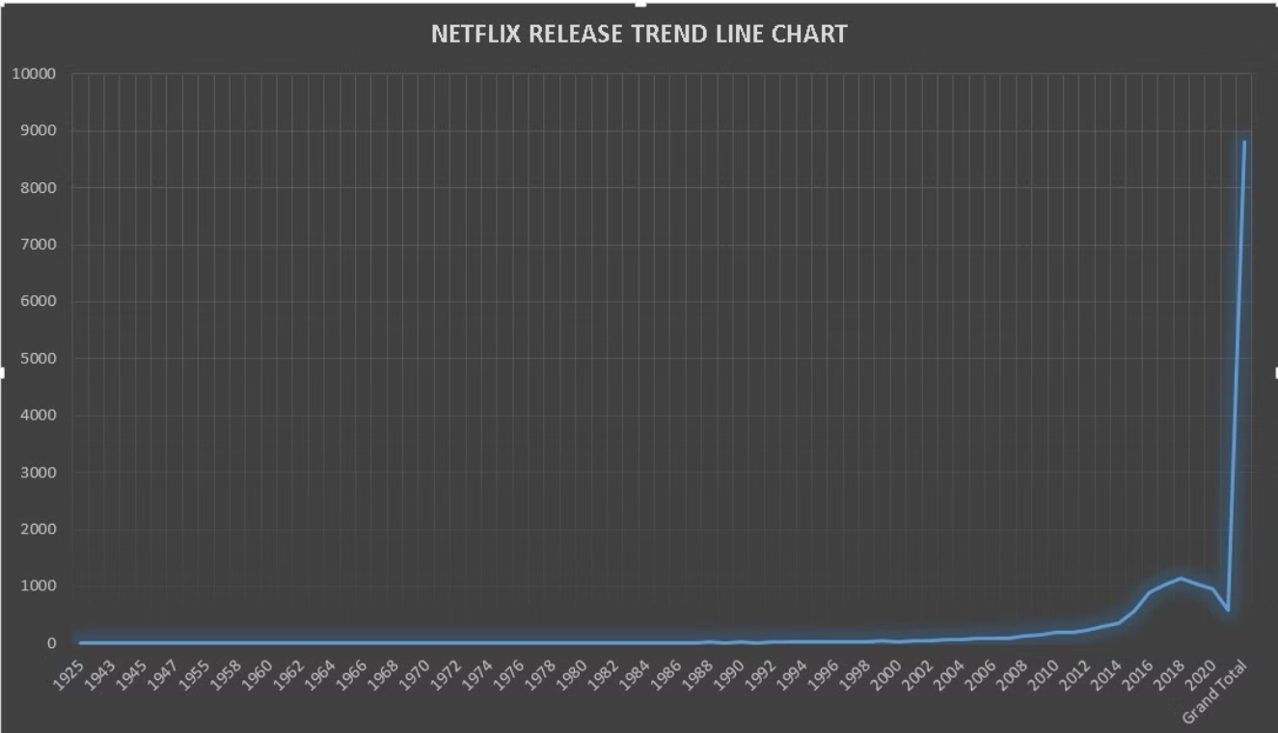
Line Chart Showing The Trend of content addition over the years:
Insight: Increasing trend in adding TV shows over time.

Slide 10

Summary
In this presentation, we explored a the Netflix-titles dataset and uncovered compelling insights. Through detailed SQL analysis and data visualization, we gained valuable knowledge about the data that can inform future decisions.
Key Findings
Significant increase in TV shows over the years.
66 min is the dominant content rating.
The United States is the top content producer.
Conclusion :
The analysis provides insights into Netflix's content strategy and trends.

Slide 11
QUESTIONS?

